Slide 1
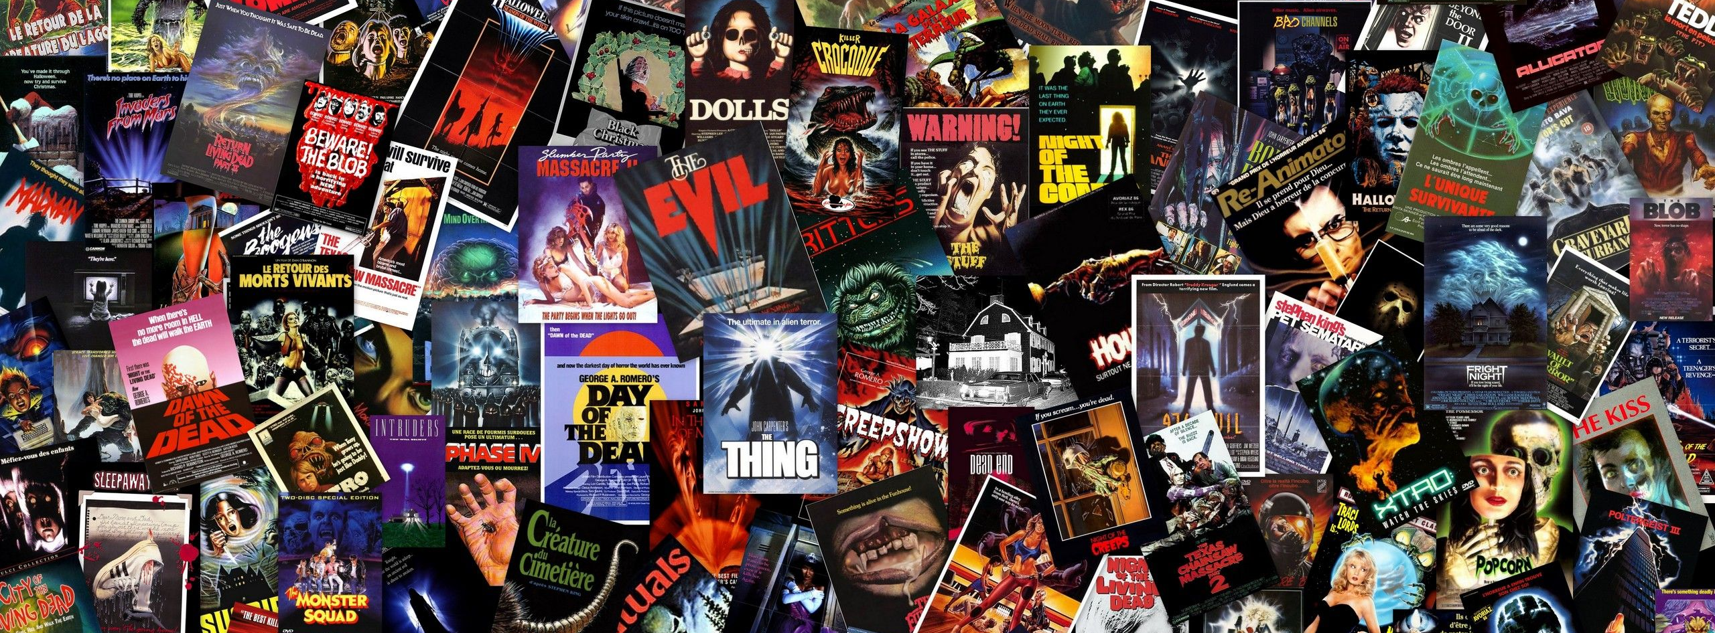
Movie Recommender System Using MovieLens Data
Sharmin kantharia

Slide 2
Introduction
Personalization and recommendations help increase business value and sales of products.
Recommender systems are a subclass of information retrieval systems.
Goal is to predict a ‘rating’ a user gives to a product or a ‘recommendation’ to a user based on past preferences.
Example Companies: Netflix, Amazon, Spotify, Zillow, Uber Eats, LinkedIn
Main Approaches: Content-based Filtering, Collaborative Filtering, Knowledge-based and Hybrid methods
Current Systems: Hybrid systems including a combination of the various approaches
Future Systems: A combination of current systems and Deep Learning models

Slide 3
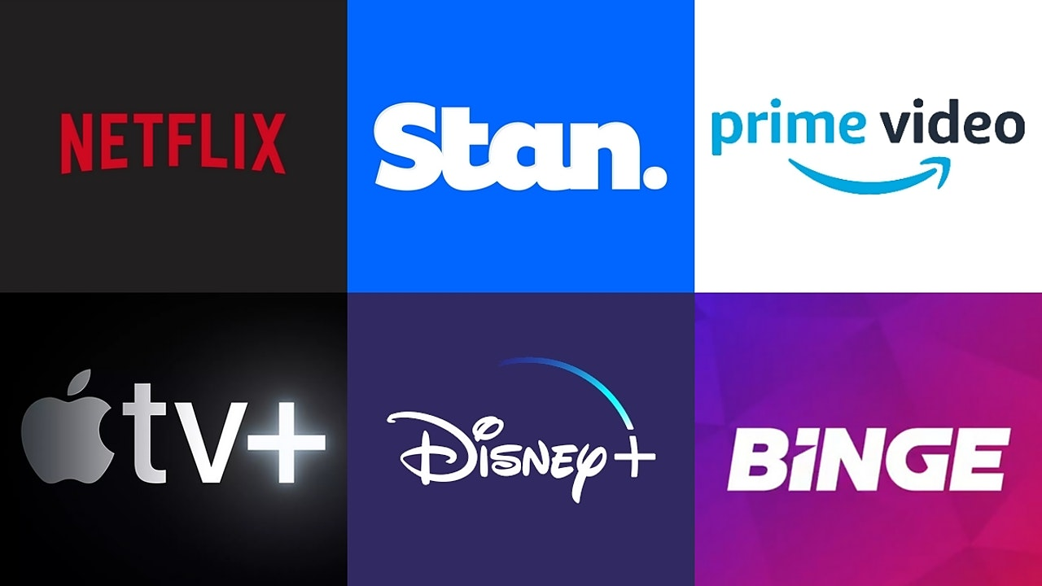
Project Overview
SMART Questions
Data & Analysis
Exploratory Data Analysis
Recommender Systems
Advantages & Disadvantages
Results
Conclusion & Future Work
References

Slide 4
SMART Questions
Question 1
Question 2
Question 3
Question 4
Generate movie recommendations based on a particular Genre
Generate movie recommendations based on Movie Similarity
Generate movie recommendations based on User Similarity
Generate movie recommendations based on a user’s Past Preferences

Slide 5
Data and Analysis
Movielens dataset
Analysis & pre-processing
MovieLens Website:
Uses collaborative filtering to provide recommendations
Utilizes ratings and reviews
GroupLens Research Lab:
Social Computing Research at University of Minnesota
Gather and publish ratings data
Data:
4 CSV files: movies, ratings, tags, links
9742 unique movies
610 unique users
100,000 ratings (ranging from 0.0 to 5.0)
Datasets ‘movies.csv’ and ‘ratings.csv’ are merged to create a main dataframe.
‘timestamp’ feature is dropped
Minimum rating given: 0.5
Maximum rating given: 5.0
Average rating: 3.5
Number of Genres: 18

Slide 6
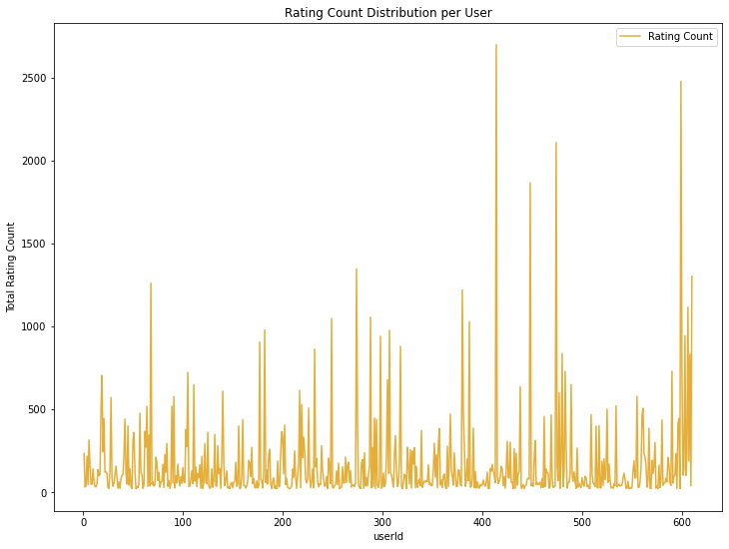
Visualization 1 – Rating Count Distribution for Each User
Exploratory Data Analysis

Slide 7
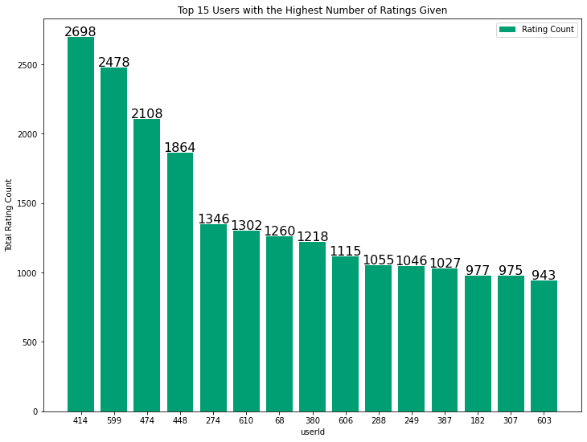
Visualization 2 – Top 15 Users with Highest Number of Ratings given

Slide 8
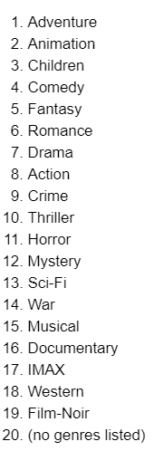
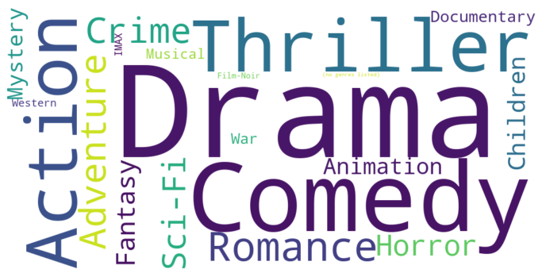
Visualization 3 – WordCloud of Movie Genres
Fig. 1
Fig. 2

Slide 9
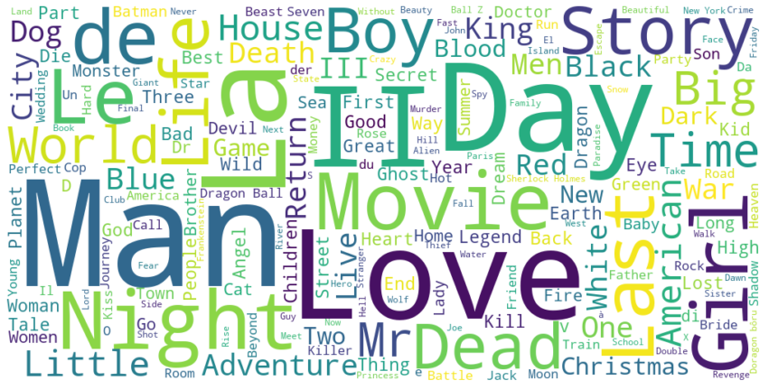
Visualization 4 – WordCloud of Movie Titles

Slide 10
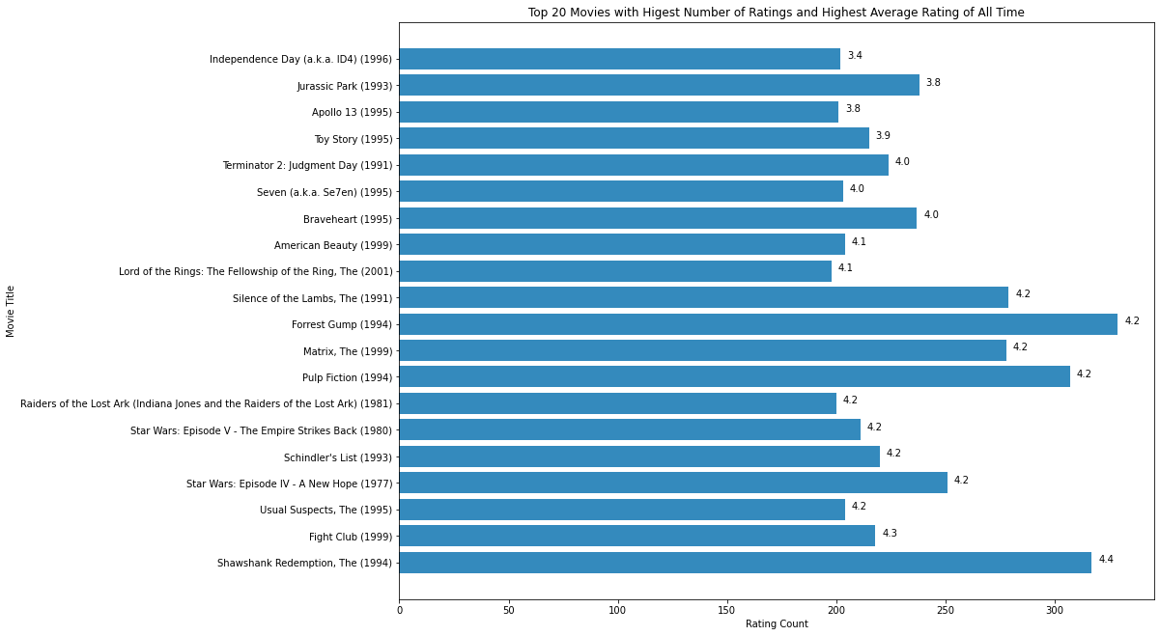
Visualization 5 – Top 20 Movies with Highest Number of Ratings and Highest Average Rating of All Time

Slide 11
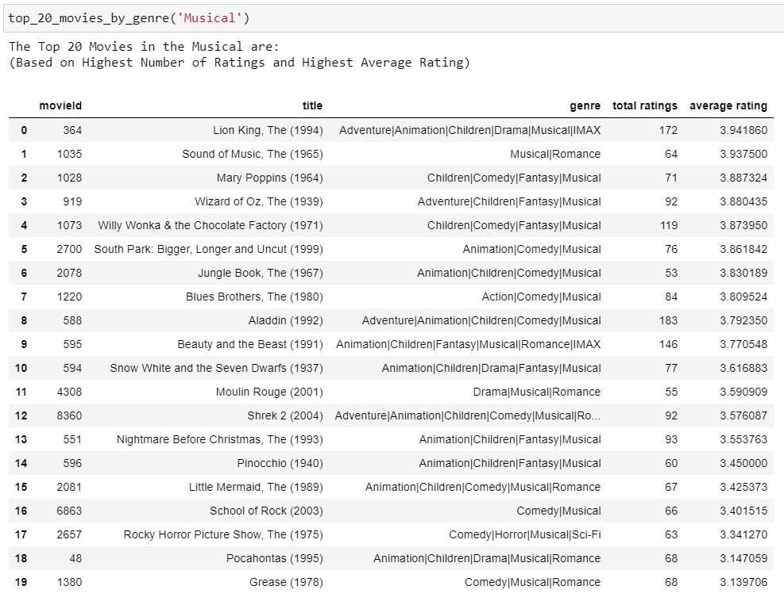
Visualization 6 – Top 20 Movies in the ‘Musical’ Genre

Slide 12
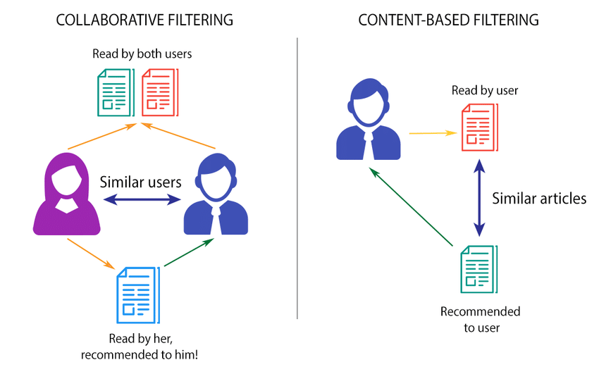
Recommender Systems
Content-based Filtering
TF-IDF & Cosine Similarity
Memory-based Collaborative Filtering
Item-based
User-based
Model-based Collaborative Filtering
Matrix Factorization
Clustering

Slide 13
Content-Based Filtering Approach
TF-IDF Scores (TfidfVectorizer)
Similarity Matrix using Cosine Similarity
Input: Target Movie Title
Find index of target movie in the Similarity Matrix
Sort based on Similarity Scores
Manipulate required Dataframes
Create a dataframe of movies similar to target movie
Recommend Top 20 movies similar to target movie

Slide 14
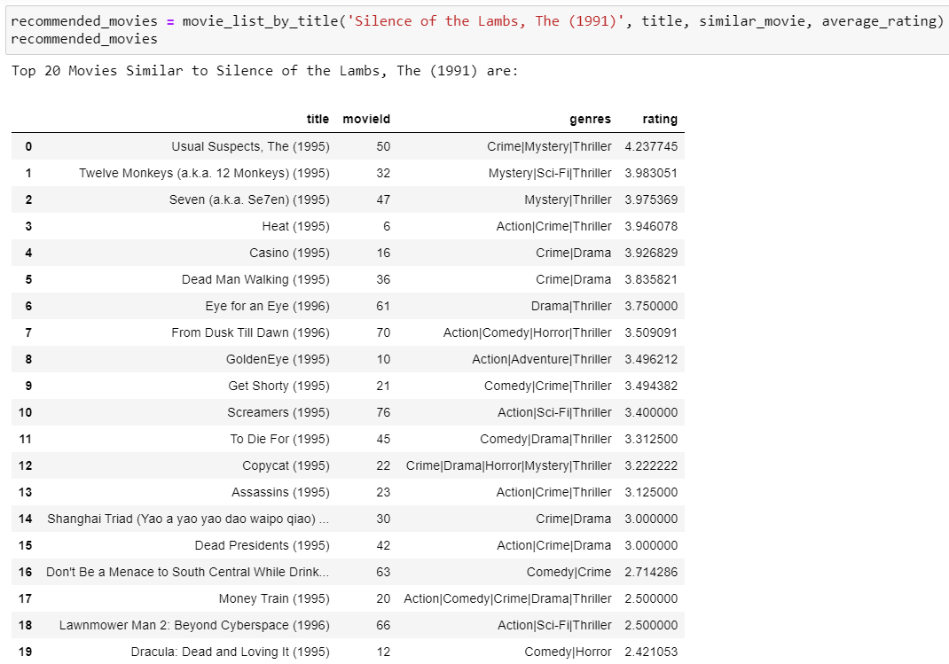
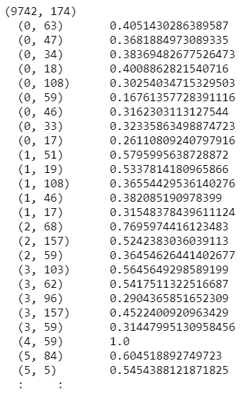
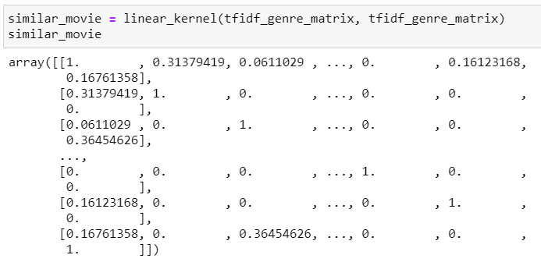
Fig. 1
Fig. 2
Fig. 3

Slide 15
Memory-Based Collaborative Filtering: Item-based Approach
Item-Based
Item-based Rating Matrix using pivot_table()
Item Similarity Matrix using Cosine Similarity
Input: Movie ID
Use Similarity Matrix to find Similar movies and Similarity Scores
Sort by Highest Similarity Score & Manipulate required Dataframes
Set average ratings threshold of 4.0 & find movies having highest similarity score
Recommend Top 20 movies similar to target movie

Slide 16
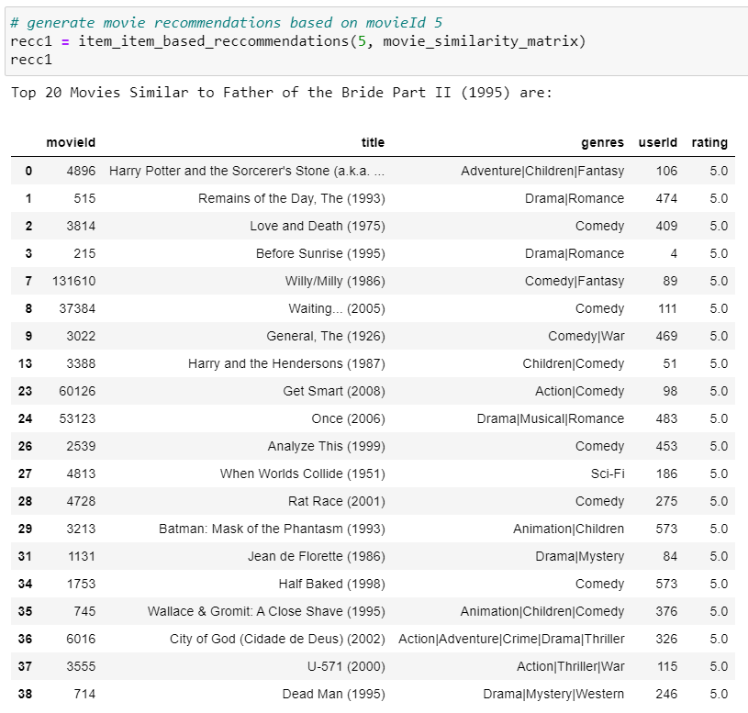
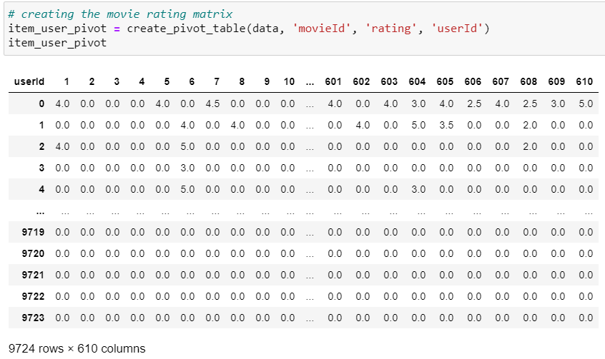
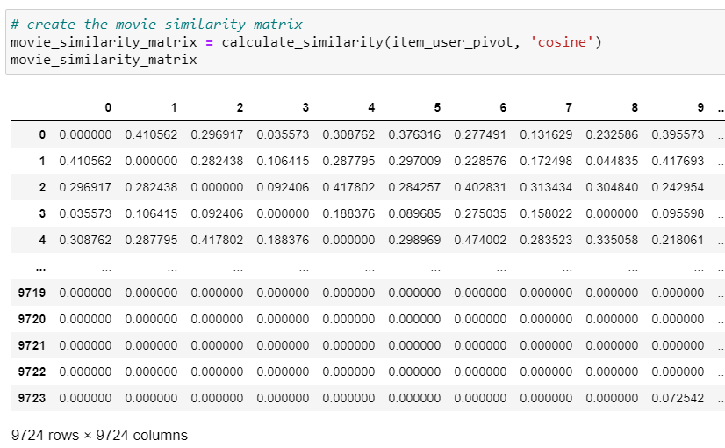
Fig. 1
Fig. 2
Fig. 3

Slide 17
Memory-Based Collaborative Filtering: User-based Approach
User-Based
User-based Rating Matrix using pivot_table()
User Similarity Matrix using Cosine Similarity
Input: User ID
Use Similarity Matrix to find Similar users and Similarity Scores
Sort by Highest Similarity Score & Manipulate required Dataframes
Find highest rated movies by Top Similar User
Recommend Top 20 movies similar to target user

Slide 18
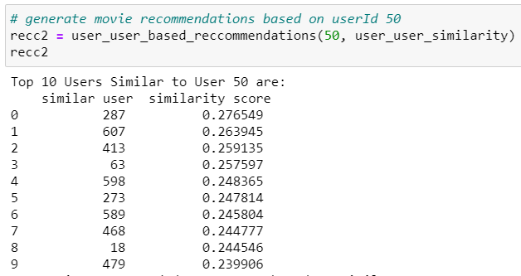
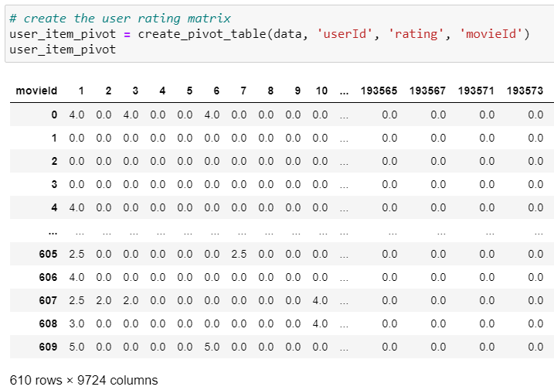
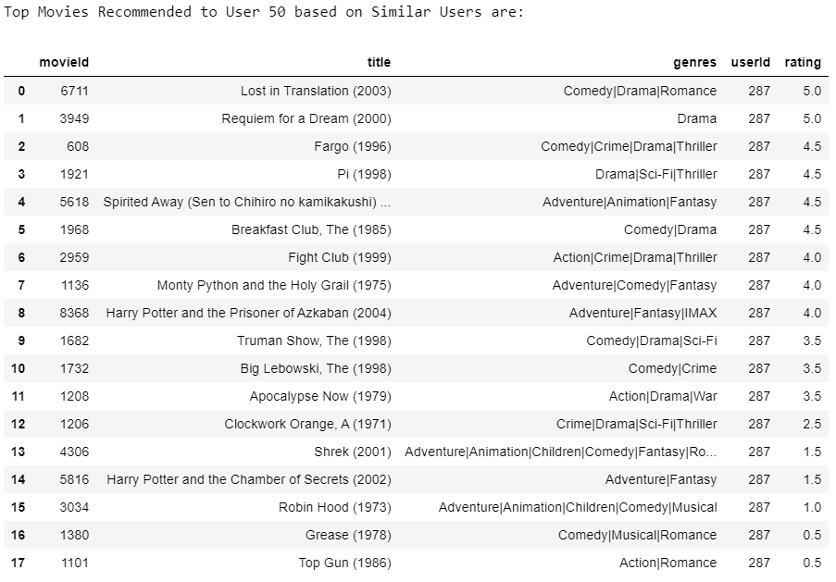
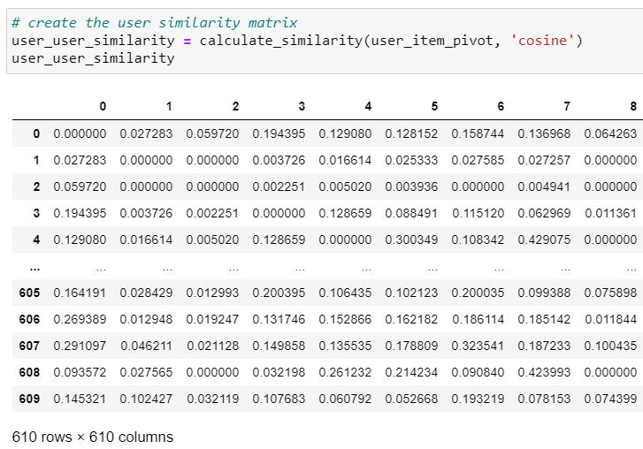
Fig. 1
Fig. 3
Fig. 2
Fig. 4

Slide 19
Model-Based Collaborative Filtering: Approach
Surprise Library – Read and Load ratings data
Perform 3-fold cross validation for SVD(), KNNBasic(), KNNWithMeans()
Pick best model, based on test RMSE, fit time and test time
Input: User ID
Exclude movies previously rated by target user
Using best model, predict the ratings for the remaining movies
Set actual and estimated rating threshold of 4.0 or above
Sort and Recommend Top 20 movies similar for a particular user

Slide 20
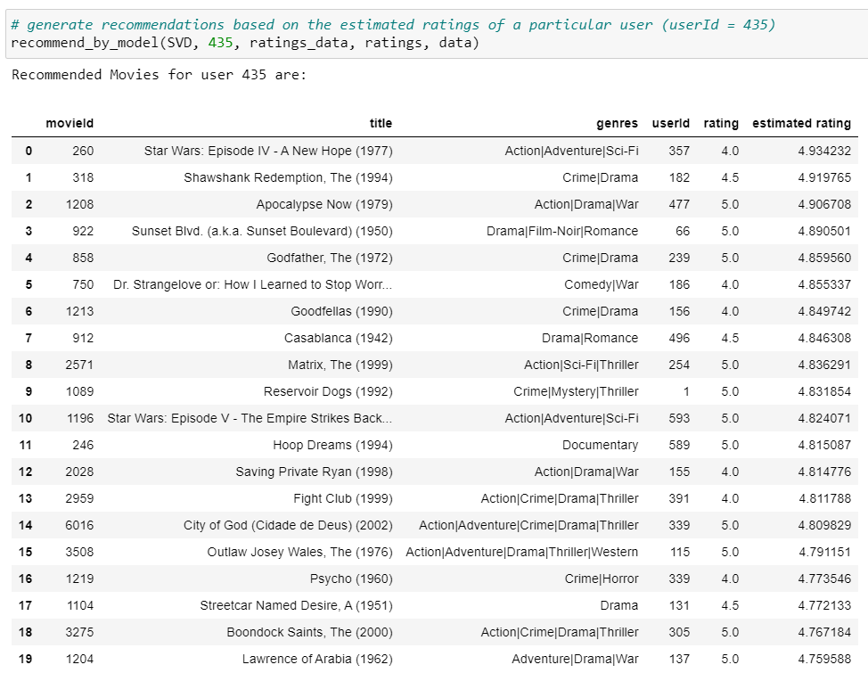
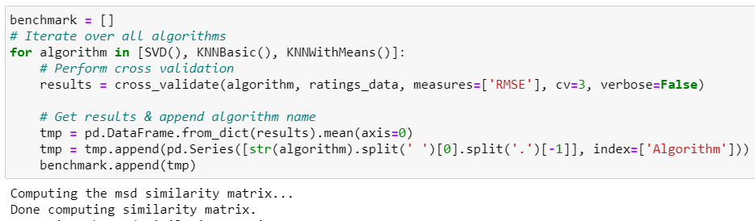
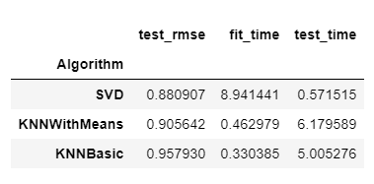
Fig. 1
Fig. 2
Fig. 3

Slide 21
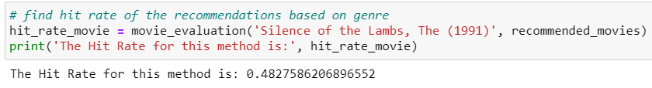
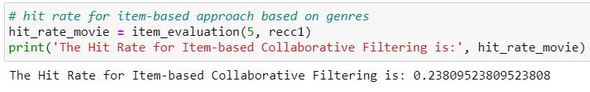
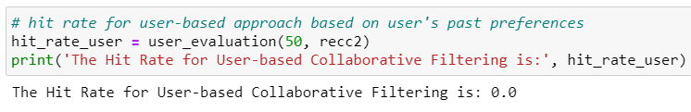
Results
Content-based Recommender System Evaluation
Item-based Recommender System Evaluation
User-based Recommender System Evaluation

Slide 22
Advantages & Disadvantages
Content-based filtering
Collaborative filtering
Can scale large number of users (since it does not need external user information to generate recommendations)
Captures specific interests of users
Models cannot expand the existing interests of a user (since it makes recommendations based on existing user)
No domain knowledge is required (embeddings are automatically learned)
Helps users expand their interests
Faces the cold-start problem (new items will not be included in the training, hence embeddings for them will not be created)

Slide 23
Summary
Conclusion/recommendations
Future work
Goal: High-level understanding of the various methods.
Model-based approach was faster and provided efficient results.
Challenges: Lack of proper evaluation methods for Top-N Recommendations.
Hybrid approaches can be more efficient and accurate.
Implementation of Deep Learning models – RNNs, LSTMs.
Extensive Hyperparameter Tuning increases performance, scalability and efficiency.
Incorporating use of implicit ratings and metadata of movies, ratings and users.

Slide 24
Demo/Links
GitHub Repository: https://github.com/sharmin2697/MovieRecommender-System
GitHub (io): https://sharmin2697.github.io/MovieRecommender-System
Zenodo: https://zenodo.org/record/4737877#.YJHWjLX0nb0

Slide 25
References
[1] F. Maxwell Harper and Joseph A. Konstan. 2015. The MovieLens Datasets: History and Context. Transactions on Interactive Intelligent Systems (TiiS) 5, 4: 19:1–19:19. https://doi.org/10.1145/2827872
[2] Lee, Joonseok & Sun, Mingxuan & Lebanon, Guy. (2012). A Comparative Study of Collaborative Filtering Algorithms. https://arxiv.org/abs/1205.3193
[3] Scott Graham, Jun-Ki Min, and Tao Wu. 2019. Microsoft recommenders: tools to accelerate developing recommender systems. In Proceedings of the 13th ACM Conference on Recommender Systems (RecSys '19). Association for Computing Machinery, New York, NY, USA, 542–543. DOI: https://doi.org/10.1145/3298689.3346967
[4] Xiaoyuan Su and Taghi M. Khoshgoftaar. 2009. A survey of collaborative filtering techniques. Adv. in Artif. Intell. 2009, Article 4 (January 2009), 1 pages. DOI: https://doi.org/10.1155/2009/421425
[5] Badrul Sarwar, George Karypis, Joseph Konstan, and John Riedl. 2001. Item-based collaborative filtering recommendation algorithms. In Proceedings of the 10th international conference on World Wide Web (WWW '01). Association for Computing Machinery, New York, NY, USA, 285–295. DOI: https://doi.org/10.1145/371920.372071
[6] Devooght, Robin & Bersini, Hugues. (2016). Collaborative Filtering with Recurrent Neural Networks. https://arxiv.org/abs/1608.07400v2
[7] Lops, P., Jannach, D., Musto, C. et al. Trends in content-based recommendation. User Model User-Adap Inter 29, 239–249 (2019). https://doi.org/10.1007/s11257-019-09231-w
[8] Achakulvisut, Titipat & Acuna, Daniel & Ruangrong, Tulakan & Kording, Konrad. (2016). Science Concierge: A Fast Content-Based Recommendation System for Scientific Publications. https://arxiv.org/abs/1604.01070v2
[9] Mustansar Ali Ghazanfar and Adam Prugel-Bennett. 2010. A Scalable, Accurate Hybrid Recommender System. In Proceedings of the 2010 Third International Conference on Knowledge Discovery and Data Mining (WKDD '10). IEEE Computer Society, USA, 94–98. DOI: https://doi.org/10.1109/WKDD.2010.117
[10] Rendle, Steffen & Zhang, Li & Koren, Yehuda. (2019). On the Difficulty of Evaluating Baselines: A Study on Recommender Systems. https://arxiv.org/abs/1905.01395v1

